Slide 1
Chapter three
Sever side programing -- servlet

Slide 2
Chapter outline
Web App Architecture
Understanding the basic web App structure
HTML review
Understanding the HTTP protocol
Java EE Web Application Structure
Directory Structure and WAR file
Servlet
Creating a Servlet class
Understanding Servlet lifecycle
Understanding doGet(), doPost()
Using parameters and accepting form submissions.

Slide 3
Web APP architecture
HTML & HTTP protocol

Slide 4




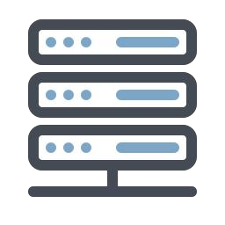

What does your web server do?
The client's request contains
The name and address (URL),
of the thing the client is looking
for.
Client
A web server takes a client request and gives something back to the client
A web browser lets a user request a resource
The web server gets the request, finds the resource, and return something to the user.
If the thing isn't there, you get the "404 Not Found" message.
Request
Server
The server's response contains the
actual document that the client
requested (or an error code if the
request could not be processed)
Response

Slide 5
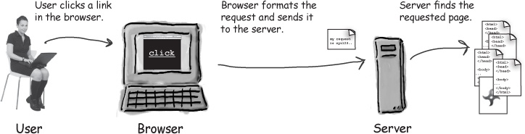
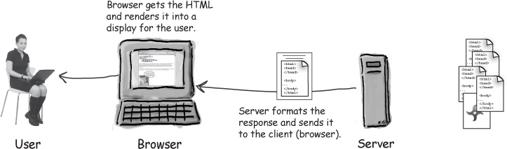
What does a web client do?
A web client lets the user request something on the server, and show the user the result of the request.
When we talk about clients, we usually mean both the human user and the browser application.

Slide 6
Clients and servers know Html and http
HTML
HTML(Hyper Text Markup Language) is the most basic building block of the web. It defines the meaning and structure of web content.
Servers often send the browser a set of instructions written in HTML
The HTML tells the browser how to present the content to the user
All web browsers know what to do with HTML.
HTTP
HTTP is the protocol clients and servers use on the web to communicate
The client sends an HTTP request, and the server answers with an HTTP response.
When a web server sends an HTML page to the client, it sends it using HTTP.

Slide 7
Simple HTML guide
Tag | Description
<!-- --> | Where you put your comments
<a> | Anchor usually for putting in hyperlink
<align> | Align the contents left, right, centered, or justified
<body> | Define the boundaries of the document's body
<br> | A line break
<center> | Center the contents
<form> | Define a form
<h1>…<h6> | Heading from level 1 to 6
<head> | Define the boundaries of the document's header
When you develop a web page, you use HTML to describe what the page should look like and how it should behave.
HTML has dozens of tags and hundreds of tag attributes,
The goal of HTML is to take a text document and add tags that tell the browser how to format the text.
<tag attributes>contents</tab>

Slide 8
Simple HTML guide
When you develop a web page, you use HTML to describe what the page should look like and how it should behave.
HTML has dozens of tags and hundreds of tag attributes,
The goal of HTML is to take a text document and add tags that tell the browser how to format the text.
<tag attributes>contents</tab>
Tag | Description
<html> | Define the boundaries of the HTML document
<input type> | Defines an input widget to a form
<p> | A new paragraph
<title> | The HTML document's title
<table> | Defines a table
<tr> | Defines a row (table row)
<td> | Defines a cell (table data)

Slide 9
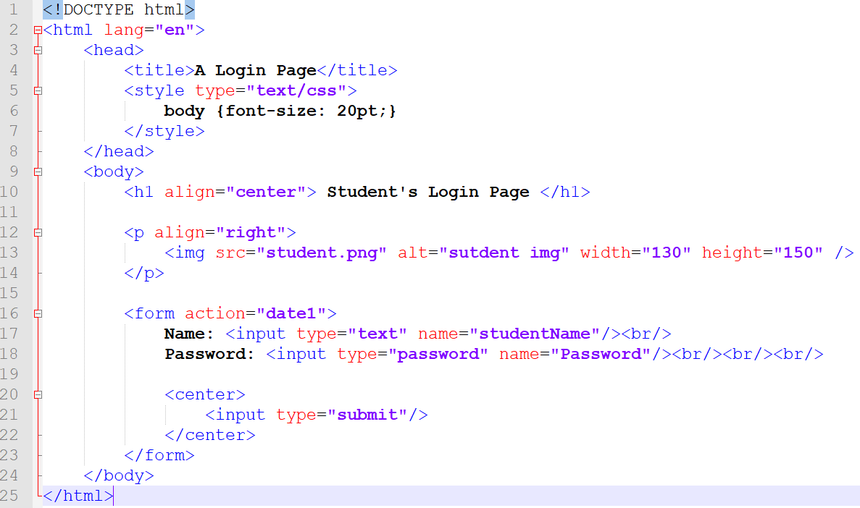
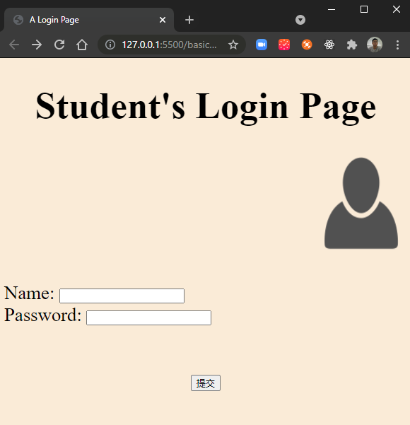
A login page
A
B
C
D
E
What in the HTML
What the browser creates

Slide 10
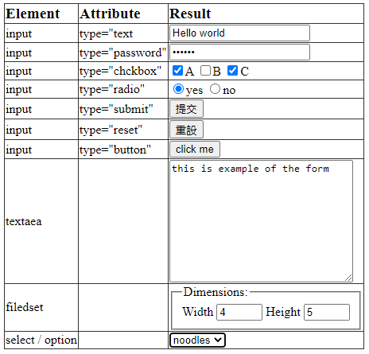
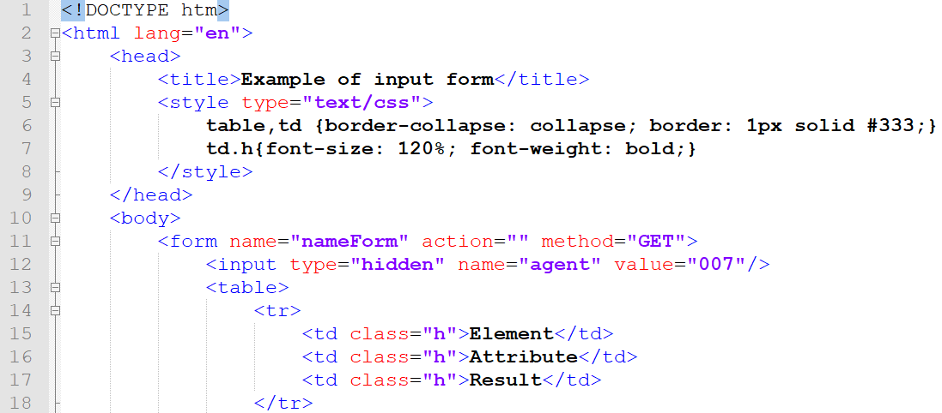
Example of input form

Slide 11
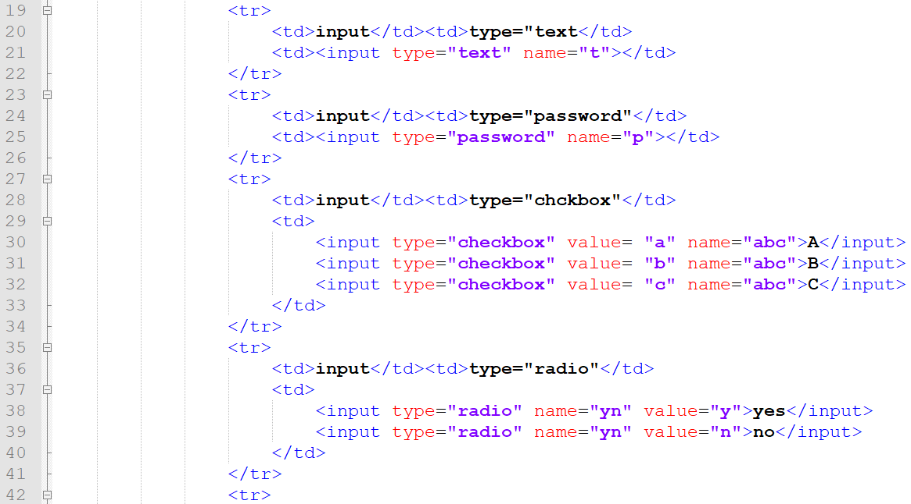
Example of input form

Slide 12
Example of input form

Slide 13
Example of input form

Slide 14
Example of input form

Slide 15
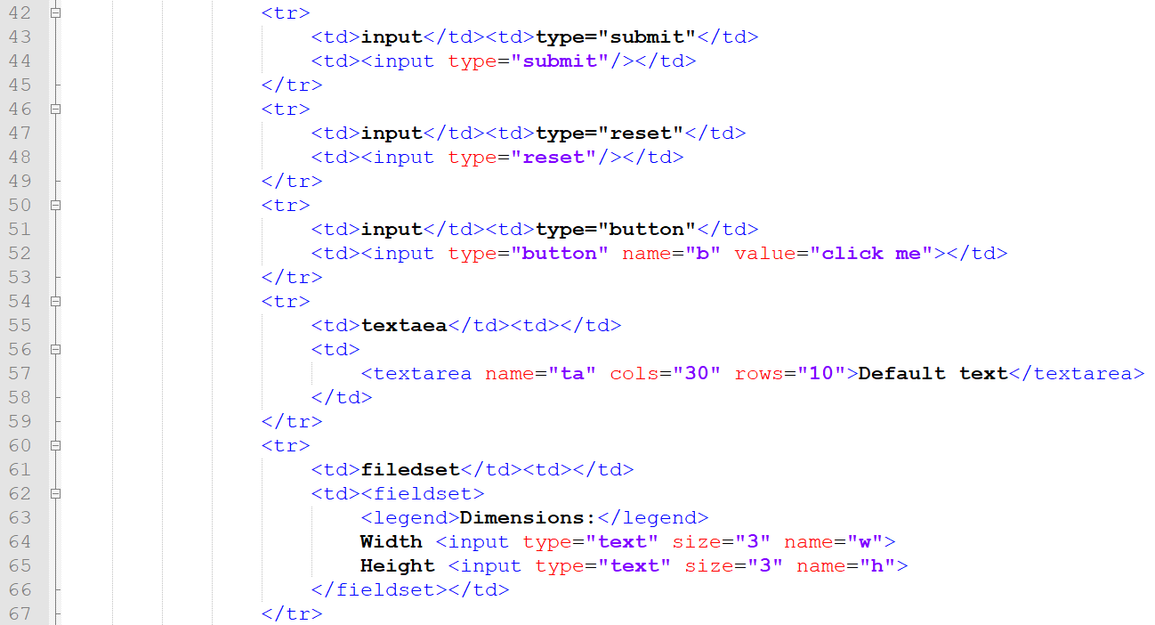
Example of input form

Slide 16
Example of input form

Slide 17
Example of input form

Slide 18
Example of input form

Slide 19
Example of input form

Slide 20
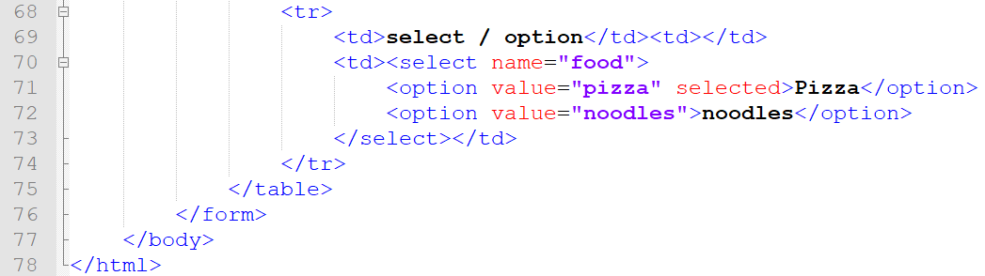
Example of input form

Slide 21
Example of input form
If you fill in the form as shown in the figure and click "submit" button, you will see in the address field of your browser that the following string appears at the end of the URL:

Slide 22
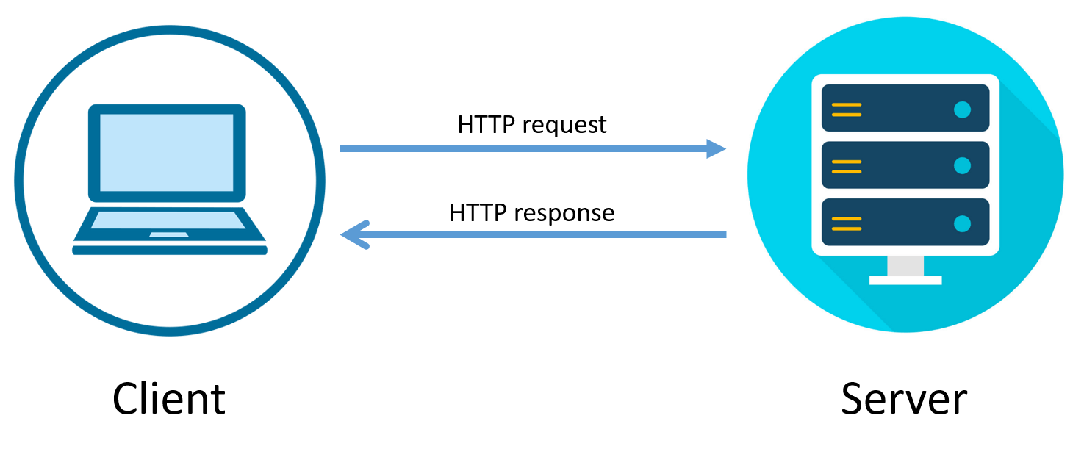
What is http protocol?
Hyper Text Transfer Protocol
Communication between web server & clients
Runs on top of TCP/IP.
The structure of an HTTP conversation is a simple Request/Response sequence
Notes:
It stands for Hyper Text Transfer Protocol
It's basically responsible for communication between web server and clients

Slide 23
Request / Response
Key elements of the request stream:
HTTP method (the action to be performed)
The page to access (a URL)
Form parameters (like arguments to method)
Key elements of the response stream:
A status code (for whether the request was successful)
Content-type (text, picture, HTML, etc.)
The content (the actual HTML, image, etc.)

Slide 24
Parts of a URL
A web address is also called a URL (Uniform Resource Locator)
From a web user's view, a URL is a piece of text.
From a web developer's view, it 's a little bit more complicated.
A URL is a name for a resource
https://en.Wikipedia.org/wiki/Fish
Scheme
Hostname
Path
Notes:
Resources : webpage, image, pdf file, Google Maps API.

Slide 25
Parts of a URL
The first part of a URL is the scheme, which tells the client how to go about accessing the resource.
http, https, file, mailto, telnet, etc.
In an HTTP URL, the next thing that appears after the scheme is a hostname
something like www.udacity.com or localhost. This tells the client which server to connect to.
In an HTTP URL , the next thing that appears is the path, which identifies a particular resource on a server.
A server can have many resources on it — such as different web pages, videos, or APIs. The path tells the server which resource the client is looking for.

Slide 26
Other URL parts
There are many other parts that can occur in a URI. Consider the difference between these two Wikipedia URLs:
https://en.wikipedia.org/wiki/Oxygen
https://en.wikipedia.org/wiki/Oxygen#Discovery
# sign is called a fragment. The browser doesn't even send it to the web server. It lets a link point to a specific named part of a resource; in HTML pages it links to an element by id.
In contrast, consider this Google Search URL:
https://www.google.com/search?q=fish
The ?q=fish is a query part of the URI. This does get sent to the server.

Slide 27
HTTP methods (verbs)
In any different types of HTTP request they must contain a HTTP method which tell the server what the client is asking it to do.
GET
Retrieves data from the server
POST
Submit data to the server
PUT
Update data already on the server
DELETE
Deletes data from the server
Other methods
https://developer.mozilla.org/en-US/docs/Web/HTTP/Methods

Slide 28
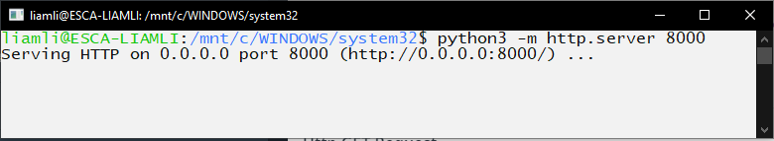
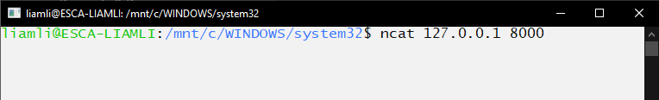
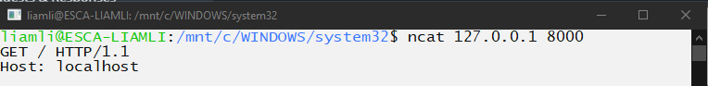
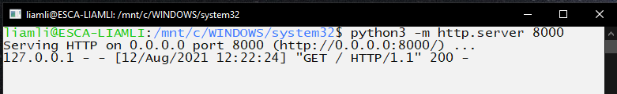
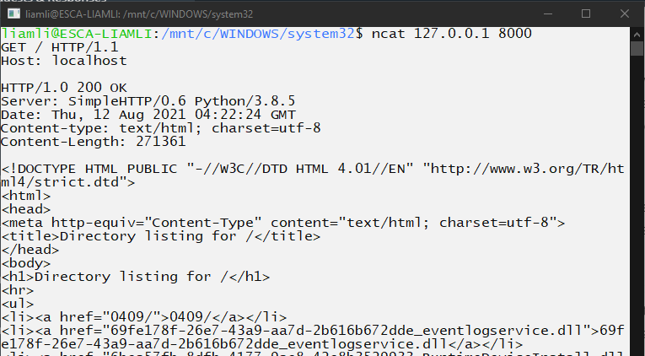
HTTP Get Request
server
Start a demo server use http.server
Open anther terminal and use ncat to connect to the demo server
Send a request manually:
Type this two lines
GET / HTTP/1.1
Host: localhost
Press Enter twice
Server received the request and sent a response back
client
client
server
client

Slide 29
HTTP Request
HTTP Request Header
HTTP
Method
Protocol
Version
Start a demo server use http.server
Open anther terminal and use ncat to connect to the demo server
Send a request manually:
Type this two lines
GET / HTTP/1.1
Host: localhost
Press Enter twice
Server received the request and sent a response back
Path
server

Slide 30
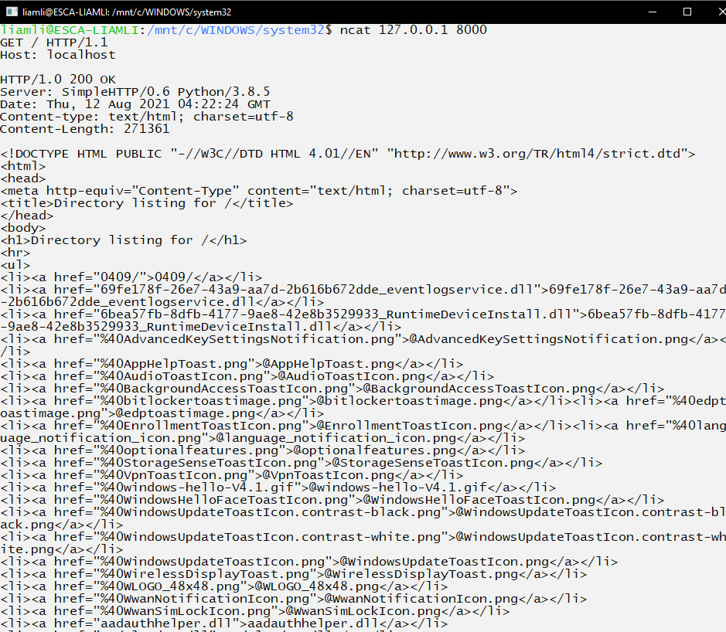
HTTP Response
Status line
Http Response Header
Server received the request and sent a response back
The HTTP response is made up of three parts:
the status line
HTTP/1.0 200 OK
some headers
and a response body.
Status Codes
1xx – informational
2xx – Success!
3xx – Redirection
4xx – Client error
5xx – Server error
HTTP Response
Notes:
Text version of status code OK

Slide 31
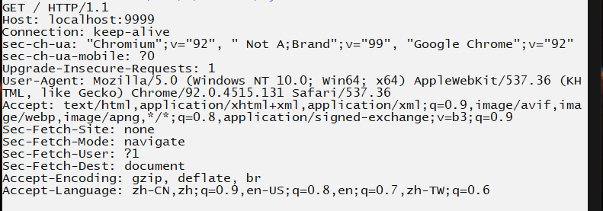
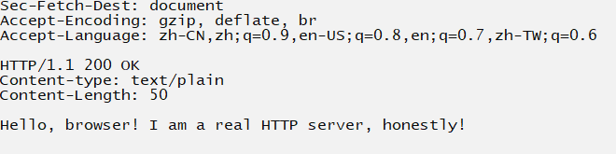
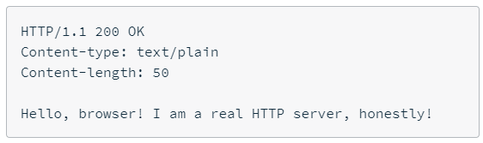
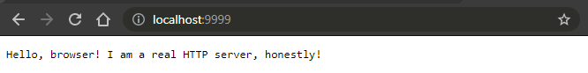
being a webserver
Use ncat to send a response to the browser.
Use command ncat –l 9999 to play a server
Get your browser to access the address: http://localhost/
Sent the response to the client
An empty line

Slide 32
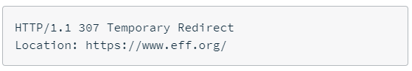
being a webserver
Let's try this

Slide 33
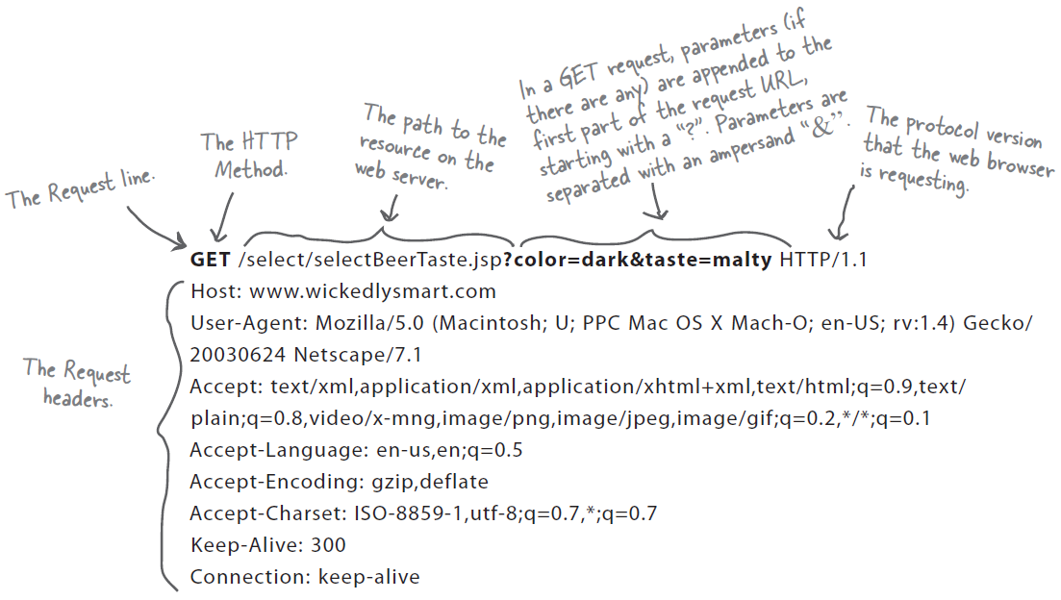
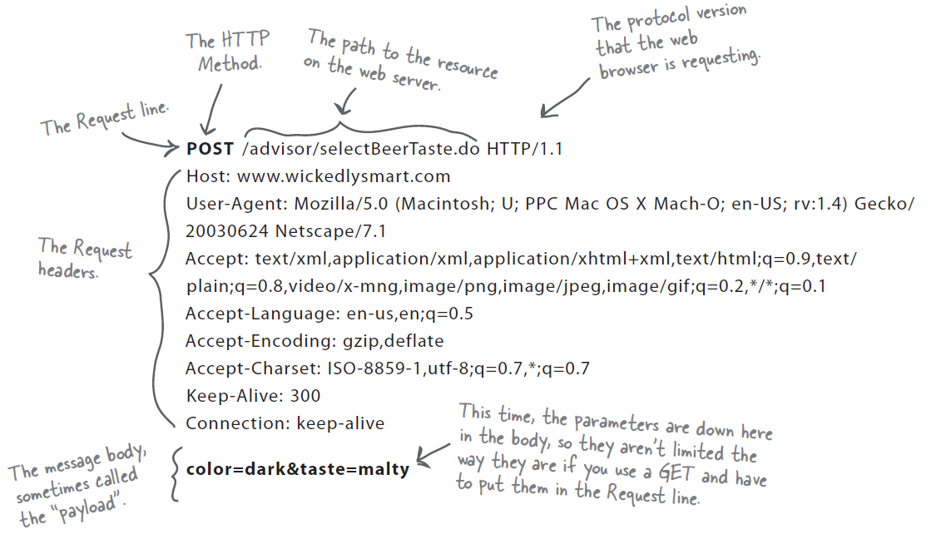
Anatomy of GET and POST request

Slide 34
GET vs Post
GET is a simple request
GET 's main job in life is to ask the server to get a resource and send it back
The resource might be an HTML page, a JPEG image, a PDF file, etc.
The path to the resource and any parameters added to the URL are all include on the "request line".
POST can send user data
POST is more powerful request
With POST you can request something and at the same time send form data to the server
The parameters added to the message body, sometimes called the "payload".

Slide 35
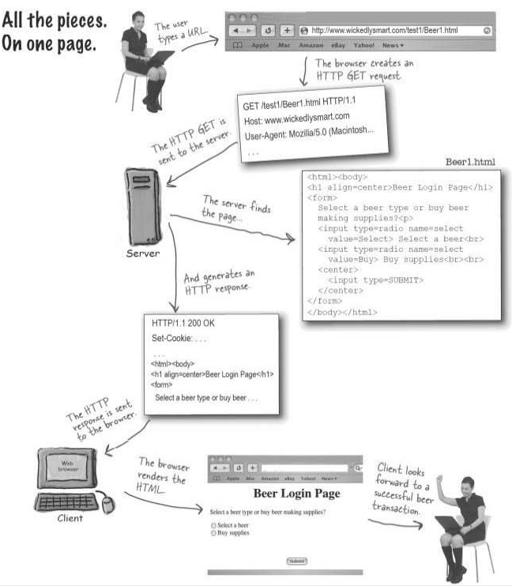

Slide 36
Static vs dynamic
Static website
Dynamic website
Static website is the basic type of website that is easy to create. You don't need the knowledge of web programming and database design to create a static website.
Its web pages are coded in HTML. The codes are fixed for each page so the information contained in the page does not change and it looks like a printed page.
Dynamic website is a collection of dynamic web pages whose content changes dynamically.
It accesses content from a database or Content Management System (CMS). Therefore, when you alter or update the content of the database, the content of the website is also altered or updated.
Dynamic website uses client-side scripting or server-side scripting, or both to generate dynamic content.

Slide 37
Static vs dynamic
Static Website | Dynamic Website
Prebuilt content is same every time the page is loaded. | Content is generated quickly and changes regularly.
It uses the HTML code for developing a website. | It uses the server side languages such as PHP,SERVLET, JSP, and ASP.NET etc. for developing a website.
It sends exactly the same response for every request. | It may generate different HTML for each of the request.
The content is only changed when someone publishes and updates the file (sends it to the web server). | The page contains "server-side" code which allows the server to generate the unique content when the page is loaded.
Flexibility is the main advantage of static website. | Content Management System (CMS) is the main advantage of dynamic website.

Slide 38
Basic Java ee Web App Structure

Slide 39
Understanding the Basic Java EE web APP structure
A lot of components go into making a Java EE web application.
Your source code and third-party libraries.
Deployment Descriptor (DD) which includes instructions for deploying and starting your application.
ClassLoaders responsible for isolating your application from other web application on the same server
You must package your application somehow, and for that you have WAR and EAR files.

Slide 40
Servlets, filters, and jsps (JAVA code)
Servlets
Servlets are a key component of any Java EE web application.
Servlets are Java classes responsible for accepting and responding to HTTP requests.
Filters
A filter is one such component that can intercept requests to your servlets
Your can use filters to meet a variety of needs, from data formatting, to response compression, to authentication and authorization.
JSPs
JSPs provide you with the means to easily create dynamic, HTML-based graphical user interfaces for your web applications without having to manually write String of HTML in the servlet.

Slide 41
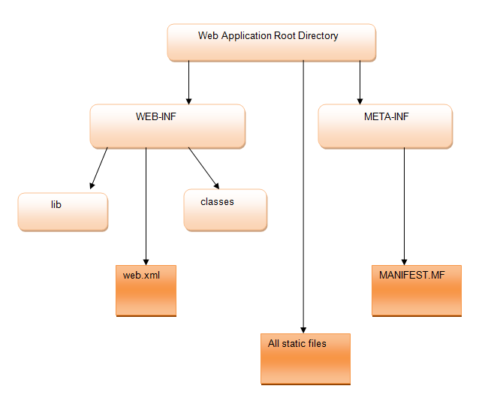
Directory Structure and WAR Files
All standard Java EE web applications are deployed as WAR file (Web Application Archive file) .
All Java EE web application servers support WAR file application archives.
The directory structure convention as shown in Figure.

Slide 42
Directory Structure and WAR Files
In any web application we can have following components
Static contents like HTML.
Client side files like CSS and JavaScript.
JSP (Java Server Pages) to generate dynamic content.
Servlets.
External library or jar files.
Any other java utility classes.
web.xml also known as deployment descriptor (DD)

Slide 43
Directory Structure and WAR Files
Web Application Root Directory
his is the main or Root folder of web application. Usually name of this folder becomes your web application context.
Example: FirstWebApplication
http://localhost:8080/FirstWebApplication
Notes:
For example ,if our web application name is FirstWebApplication , then folder name will be FirstWebApplication and web application will be accessible via http://localhost:8080/FirstWebApplication

Slide 44
Directory Structure and WAR Files
WEB-INF
This is the special directory under web application root directory.
This is secured folder and files available within this folder will not be accessible to client directly.
Which means say if this directory has one file “index.html” then this file cannot be accessed directly via http://localhost:8080/FirstWebApplication/index.html
Notes:
For example ,if our web application name is FirstWebApplication , then folder name will be FirstWebApplication and web application will be accessible via http://localhost:8080/FirstWebApplication

Slide 45
Directory Structure and WAR Files
WEB-INF/lib
All the required jar files or third party jar files will be placed inside this directory.
WEB-INF/classes
All the java code including servlets for the web application will go inside classes folder.
We can also put our own classes into a JAR file, and place it here, rather than putting those classes in the lib directory.
Notes:
For example ,if our web application name is FirstWebApplication , then folder name will be FirstWebApplication and web application will be accessible via http://localhost:8080/FirstWebApplication

Slide 46
Directory Structure and WAR Files
WEB-INF/web.xml
web.xml resides under WEB-INF folder and it is also known as deployment descriptor.
All the configuration of web application like servlets configuration, filters configuration, welcome file list etc. are configured in web.xml.
Notes:
For example ,if our web application name is FirstWebApplication , then folder name will be FirstWebApplication and web application will be accessible via http://localhost:8080/FirstWebApplication

Slide 47
Directory Structure and WAR Files
META-INF/MANIFEST.MF
This is the manifest file that can contain information about the files packaged in a WAR file's manifest.
Static Files
All static files like HTML, CSS ,JavaScript will be placed directly under web application root directory. If we want to make these files secure , we need to place these files under WEB-INF directory.
Notes:
For example ,if our web application name is FirstWebApplication , then folder name will be FirstWebApplication and web application will be accessible via http://localhost:8080/FirstWebApplication

Slide 48
Java Servlet development

Slide 49
What is a Java servlet?
A Servlet is an object that receives an HTTP request and generates an HTTP response based on that request
A Servlet is a lowest level of a Java Component that can handle network requests besides a Java Socket.
A Servlet can only support the HTTP protocol
A Servlet is mapped to a URI. Any HTTP requests made to that URI are then handled by the Servlet
A Servlet when invoked follows a life cycle defined by the Enterprise Java Specification: init->service->destroy
A Servlet has methods that you can override to execute code within the life cycle phase.

Slide 50
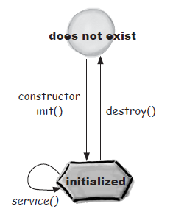
Java Servlet Lifecycle
A complete Servlet program consists of three methods
init(), service(), destroy()
Stay most of the life time on service()
Require to implement service()
doGet(), doPost()
Other commonly used API
ServletConfig
ServletContext
ServletContextListener
Where will the Java Servlet runs on
Java Web Container
Microsoft IIS doesn’t support Java

Slide 51
Java Servlet Lifecycle
A servlet life cycle can be defined as the entire process from its creation till the destruction. The following are the paths followed by a servlet.
Servlet class is loaded into web container （Tomcat）
•Servlet instance is created (constructor run)
The servlet is initialized by calling the init() method.
The servlet calls service() method to process a client's request.
The servlet is terminated by calling the destroy() method.

Slide 52
Java Servlet Lifecycle
The class loader is responsible to load the servlet class. The servlet class is loaded when the first request for the servlet is received by the web container.
The web container creates the instance of a servlet after loading the servlet class. The servlet instance is created only once in the servlet life cycle.
After the Servlet is instantiated successfully, the web container initializes the instantiated Servlet object. The container initializes the Servlet object by invoking the init() method

Slide 53
The init() Method
The init()method is called only once after creating the servlet instance.
not called for any user requests afterwards.
Syntax of the init()method is given below:
public void init(ServletConfig config) throws ServletException {
// Initialization code…
}
public void init() throws ServletException {
// Initialization code…
}
Notes:
It is called only when the servlet is created.
The servlet is normally created when a user first invokes a URL corresponding to the servlet, but you can also specify that the servlet be loaded when the server is first started.

Slide 54
Service()method is invoked
The web container calls the service() method each time when request for the servlet is received.
The service()method is the main method to perform the actual task.
The web server calls the service() method to handle requests coming from the client( browsers) and to write the formatted response back to the client.

Slide 55
Service()method is invoked
Each time the server receives a request for a servlet, the server spawns a new thread and calls service. The service() method checks the HTTP request type (GET, POST, PUT, DELETE, etc.) and calls doGet(), doPost(), doPut(), doDelete(), etc. methods as appropriate.
Ser
Client A
Thread A
Web
container
Servlet
instance
Client B
Thread B

Slide 56
Service()method
The syntax of the service method of the Servlet interface is given below:
you have nothing to do with service() method but you override either doGet()or doPost()depending on what type of request you receive from the client.
public void service(ServletRequest request, ServletResponse response)
throws ServletException, IOException

Slide 57
The destroy()Method
A server calls the destroy method after all service calls have been completed.
Java Servlet will be destroyed when container does not have enough memory and try to kill the idle objects include Java Servlet.
Java Servlet will be destroyed when its idle time is over the preset timeout parameter.

Slide 58
The destroy() Method
The destroy()method is called only once at the end of the life cycle of a servlet. This method gives your servlet a chance to close database connections, halt background threads, write cookie lists or hit counts to disk, and perform other such cleanup activities
After the destroy()method is called, the servlet object is marked for garbage collection. The destroy()method definition looks like this .
public void destroy() {
// Finalization code...
}

Slide 59
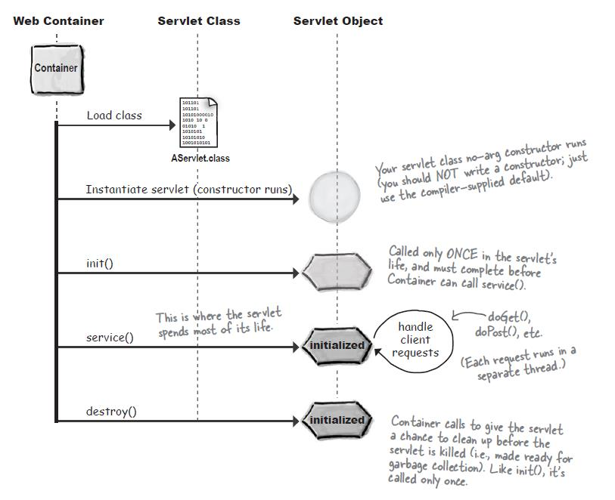
Servlet Lifecycle inside the Container

Slide 60
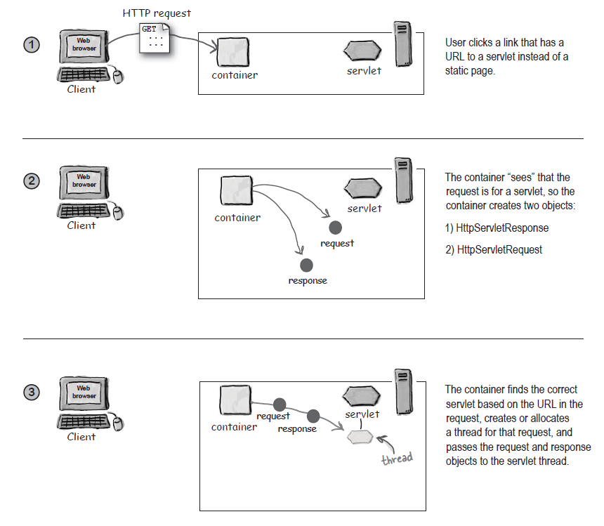
A Simple Transaction Flow

Slide 61
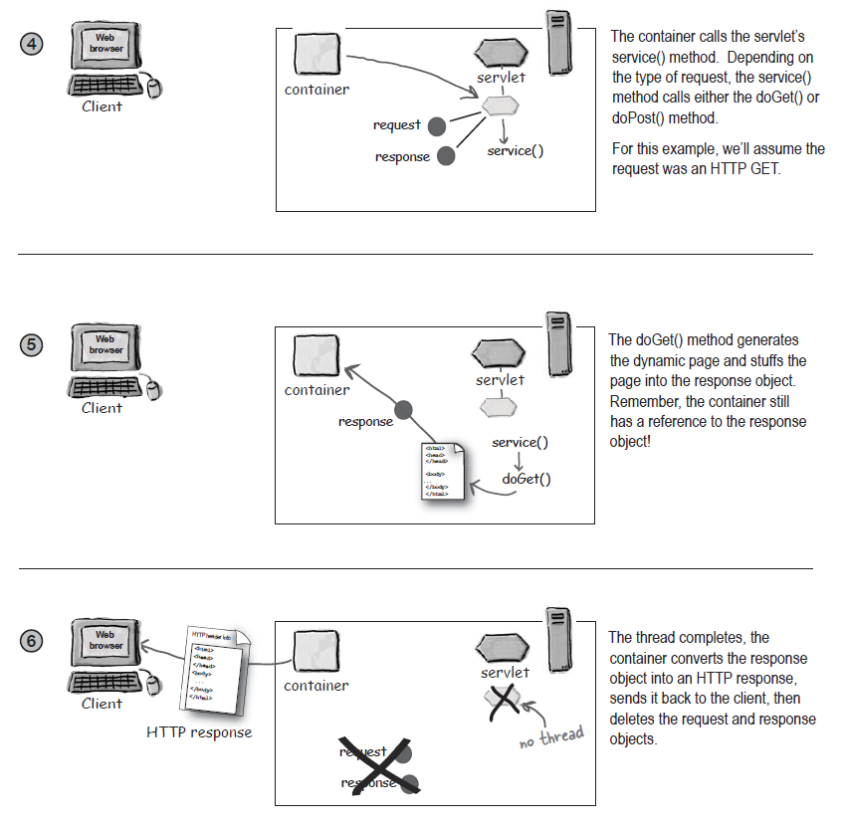
A Simple Transaction Flow

Slide 62
Java Servlet Implementation
Java Servlets need to extend the HttpServlet class
javax.servlet.http.HttpServlet
Servlet package can be found in Apache Tomcat (servlet-api.jar)
Minimal work for developing a Java Servlet is to implement the doGet() and doPost() methods.
public void doGet(HttpServletRequestrequest, HttpServletResponseresponse) throws IOException, ServletException{ … }
public void doPost(HttpServletRequestrequest, HttpServletResponseresponse) throws IOException, ServletException{ … }
Java Servlets use the PrintWriter object to output HTML codes and results to client
PrintWriter out = response.getWrite();
Out.println("….");

Slide 63
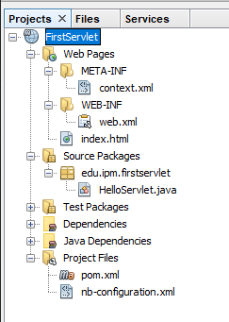
Java Servlet Example 1
The project folder Structure
Web Pages
All web page related contents
WETA-INF, WEB-INF
Source Packages
All source files in this folder
Test Packages
Dependencies
Libraries (javaee-web-api etc.)
Java Dependencies
JDK, javaee-endorsed-api
Project Files
Meven pom.xml

Slide 64
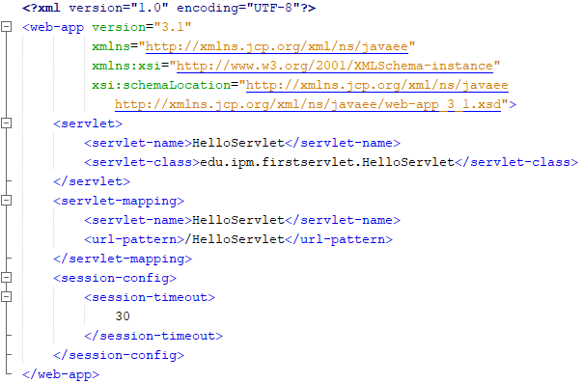
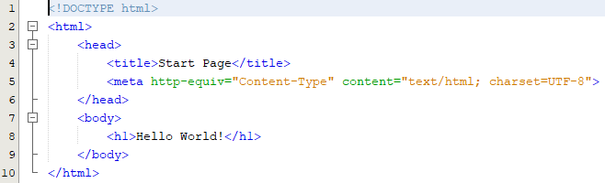
Index.html &web.xml
Web.xml
index.html

Slide 65
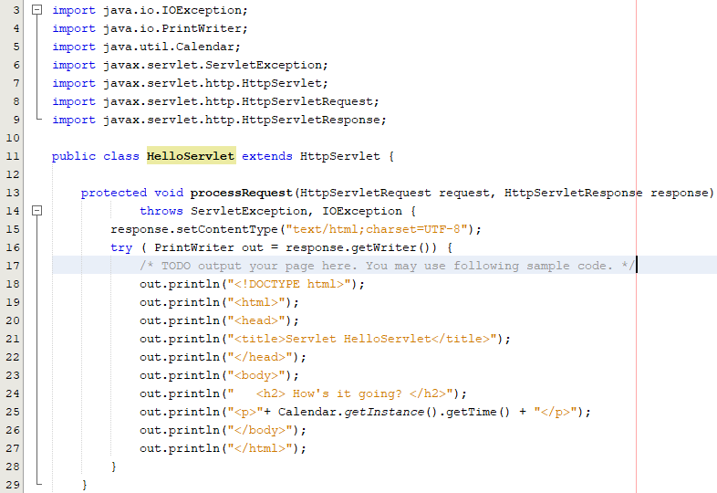
Java Servlet Example 1

Slide 66
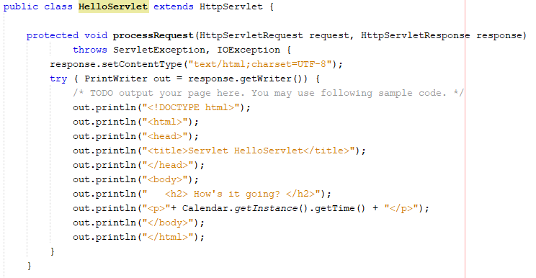
Example 1

Slide 67
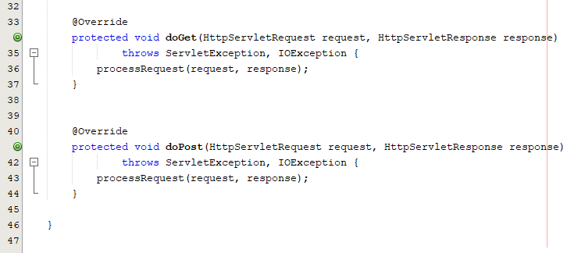
Example 1 (cont.)

Slide 68
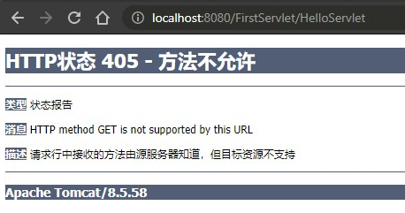
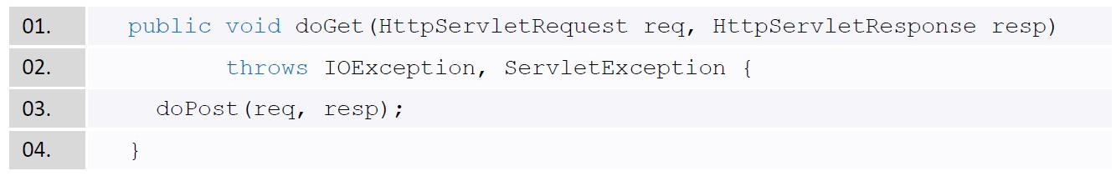
Servlet without doGet()
GET is the default method for submitting HTML <form>
<form> … </form> <!– doesn't specify the submit type -->
A No Get Servlet doesn't implement the doGet() method
The following message will be shown when you submit the data through GET method
The good practice is always to implement both doGet() and doPost() methods; however, having two methods with the same content is not good to maintain. Therefore, it is better to "forward" one to the other

Slide 69
Application Deployment
WAR (Web Application ARchive)
Is a JAR file to distribute a collection of JSP, Servlet, class, XML, tag library, HTML pages, etc.
Can be digitally signed as JAR file to assert the code is trusted
EAR (Enterprise ARchive)
A standard JAR file used by Java EE for packing the whole application (program and configuration) into a single archive for deploy to different platform.
It must contain a DD (Deployment Descriptors) XML to describe how the application will be deployed.
It contains a WAR file (web application) for deployment
It may contain Enterprise Java Beans (Message Beans and Session Beans) for remote access.

Slide 70
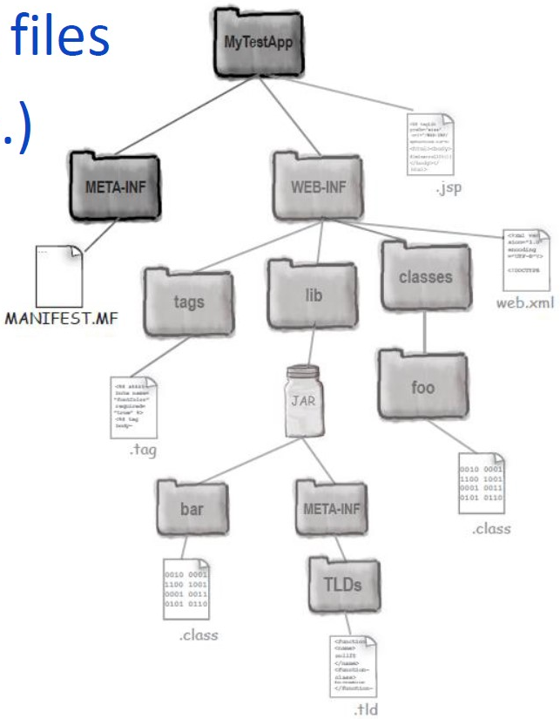
WAR content and file structure
Organize the programs for web container
Web Container will unpack the files
Root folder (WebContent/app.)
JSP, HTML, image, JavaScript, CSS
META-INF
MANIFEST.MF
WEB-INF
web.xml (Deployment Descriptor)
classes
Java Servlet, JavaBean, properties
lib
JAR files, DLL files, other library files
tages
JSP Tag Library

Slide 71
Deployment Descriptor (web.xml)
To describe the web application
Define default homepage
Define Java Servlet mapping path
Define an event listener class
Set up resource reference
Session control
Etc.
Full Documentation:
http://docs.oracle.com/cd/E13222_01/wls/docs81/webapp/web_xml.html
There are plenty of tools for building the web.xml such as Apache Ant, Maven, eclipse, etc.

Slide 72
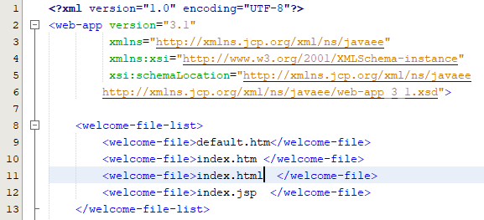
Web.xml example
Homepage setting allows user not to type the name of the first page

Slide 73
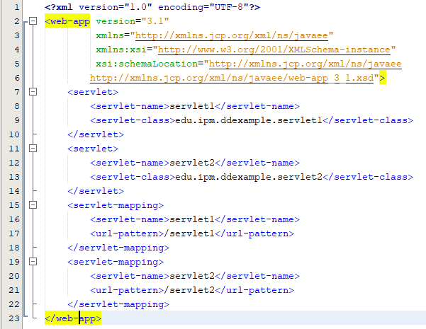
Servlet mapping in web.xml
Java Servlet mapping in deployment descriptor
<servlet> the place to defined a servlet
<servlet-name> Internal Mapping Name
only used inside the web.xml for mapping between <servlet>and <servlet-mapping> tags
<servlet-class> Actual Class Name
The absolute path of the actual class location. It only appears inside the <servlet> tags

Slide 74
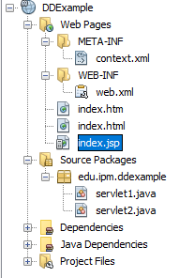
Servlet mapping in web.xml (con.)
<url-pattern> Virtual Client Name
The servlet name for client to use. It will be disposed in HTML or JSP files. It only appears inside the <servlet-mapping> tags
Example Client visits a link (http://liamipm.cyou:8080/DDExample/servlet1 ) will actually call the Java Servlet (edu.ipm.ddexample.servlet1)

Slide 75
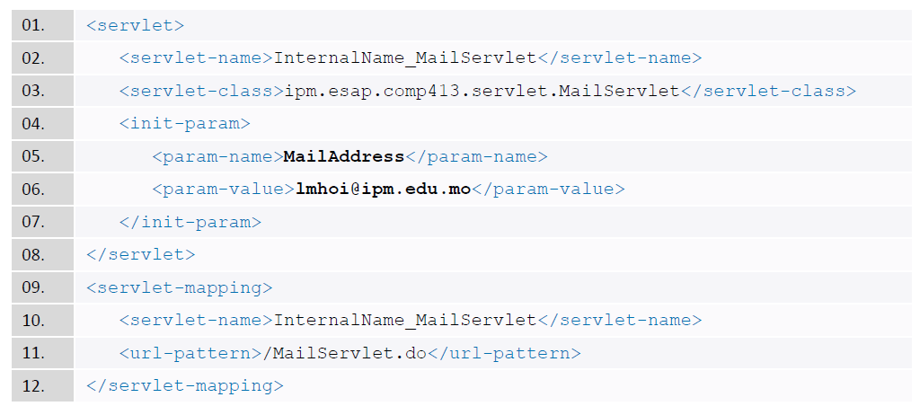
Servlet initialization Parameters
You can define parameters (name-value pair) for servlets in web.xml
The <init-param> element of the <servlet> element, using <param-name> and <param-value> tags

Slide 76
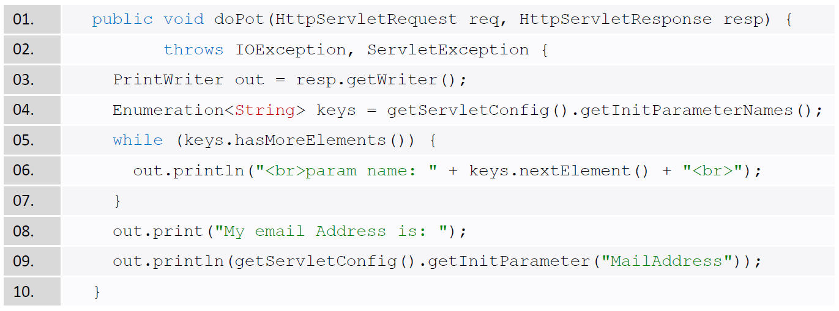
Java Servlet reads the Initialization Parameters
Once the <init-param> has been defined in the web.xml, Servlet can have a global constant parameters

Slide 77
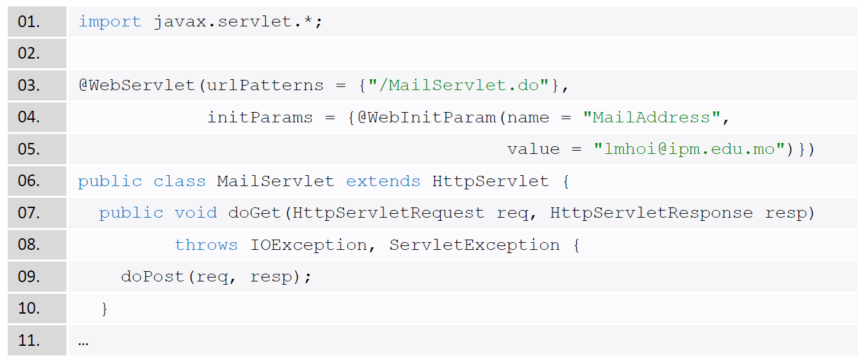
Alternative Approach
Some IDEs can generate the mapping and initial parameters directly inside the program
Making changes will require to recompile the program
Need import javax.servlet.annotation

Slide 78
Reason for Mapping the Servlet
Information Hiding
Do not need to hard-coded the real path and file name when calling this servlet.
Do not let people to know the directory structure of your application. If the end-users know the real path, they may try to access other Servlets directly
Flexibility
By mapping the name instead of coding the real file and path name, you have the flexibility to move things around without having the maintenance nightmare of tracking down and changing client code that refers to the old location of the servlet files

Slide 79
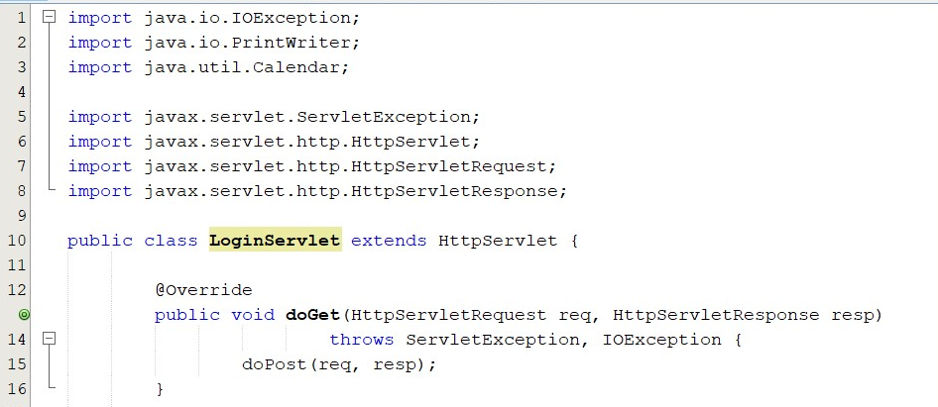
Servlet Example: login (doGet)

Slide 80
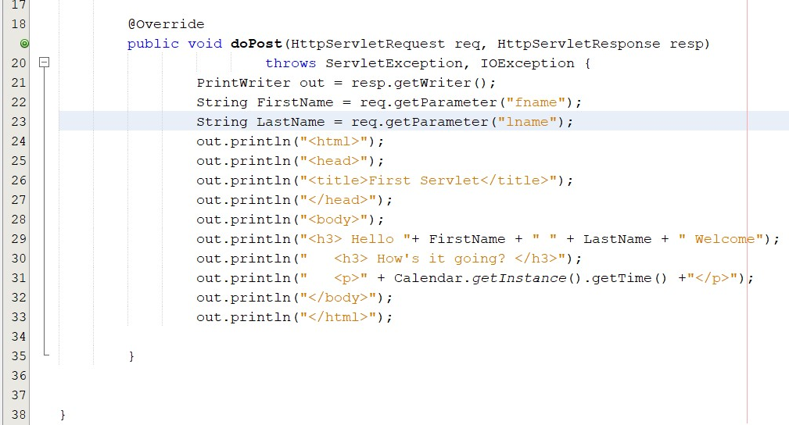
Servlet Example: login (dopost)

Slide 81
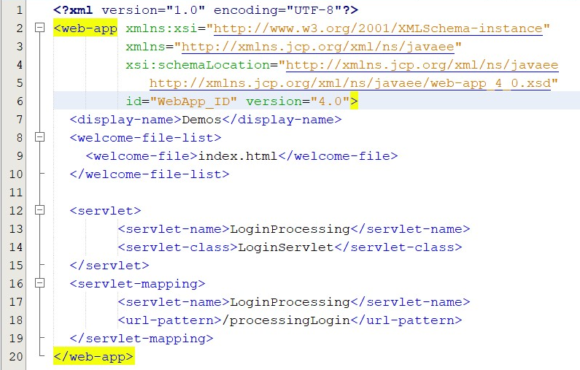
Servlet Example: login (web.xml)

Slide 82
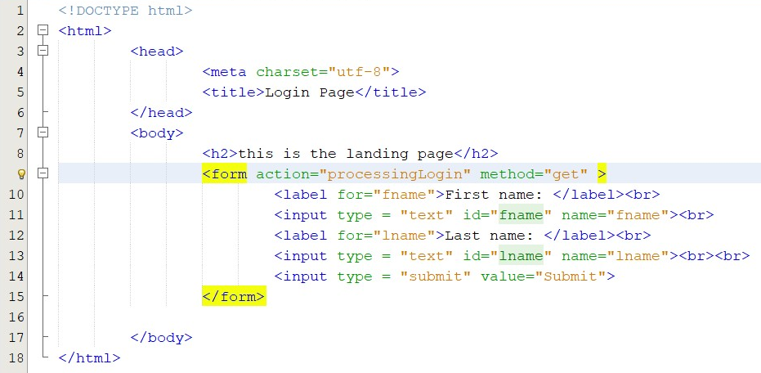
Servlet Example: login (index.html)

Slide 83
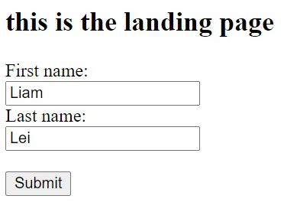

Servlet Example: login (clients view)

Slide 84
Deploying Application in Web container

Slide 85
Java Web Container – Apache Tomcat
Apache Tomcat is one of the famous Java web containers. It provides the following main features.
Communication Support
Once the servlet is deployed into the container, it will be loaded and listen to the web request. Developers can only focus on the business logic.
Lifecycle Management
Container controls the life and death of the servlets. It also handles the loading, instantiating, initializing the servlets, invoking the servlet methods, and collecting garbage to release server resources.

Slide 86
Java Web Container – Apache Tomcat
Multi-threading Support
Container creates and manages threads for multiple requests to a servlet.
Declarative Security
Application deployment (Deployment Descriptor DD) and server configuration are supported of using XML instead of coding inside your application.
As a result, changes can be made without recompiling your programs.

Slide 87
Web Container Behaviors
When the application server is started, Java Servlet is automatically loaded into memory of the web container.
Changing the Java Servlet may require to restart the web container.
When application server gets a request for Java Servlet, it will pass to the Container first.
Container will find the Java Servlet for serving the request.

Slide 88
Tomcat Directories/Files Description
Directory | Description
bin | The binary executables and scripts
conf | Configuration files
lib | JAR files that contain classes that are available to all Web application
logs | Log files
temp | Temp files
webapps | Web applications
work | Temporary files and directories for Tomcat

Slide 89
Deploying Applications in Tomcat
You have two options for deploying applications in Tomcat
Manually by placing the application in the web apps directory
Using the Tomcat manager application

Slide 90
How to Deploy a Web Application
Our application should be under the \tomcatPath\webapps directory
All applications that use servlets must have the WEB-INF and WEB-INF\classes directories
We can create a root directory for our application under the \tomcat\webapps directory
e.g. c:\tomcat\webapps\myServlet
All directories and files pertaining to our applications should be under this directory

Slide 91
Java Database Connectivity (JDBC)

Slide 92
MySQL Database
It is owned by Oracle with both Open Source and Commercial version
High performance, ease to use, and support large-scale applications
Can run on multiple platforms (Linux, Windows, Solaris, IBM AIX, Macintosh, etc.)
A member of the famous LAMP (Linux, Apache, MySQL, PHP) in modern web application development
Many enterprises are using it (Wikipedia, Google, Facebook, Flickr, Twitter, YouTube, etc.)
http://en.wikipedia.org/wiki/Programming_languages_used_in_most_popular_websites

Slide 93

MySQL Database
MySQL Fundamental Software
MySQL Community Server (General Public License)
MySQL Workbench (Client GUI Tool)
Connector/ODBC (ODBC library)
Connector/J (JDBC library)
It is chosen to be the database engine for this course

Slide 94
Databases communication in Java
Java applications use JDBC to communicate with databases
Java Database Connectivity (JDBC) is developed by Sun Microsystems
Sun Microsystems released JDBC as part of JDK 1.1 on 1997
Latest version is JDBC 21.1 specified in JSR 221 and is included in JDK 11 or above.
Industrial standard for Java to access enterprise level database engines

Slide 95

Database programming in Java
Load and regester JDBC driver
Get a Connection object from the DriverManager
Create Statement, PreparedStatement, or Callable Statement
Execute Statement, PreparedStatement, or Callable Statement to return results

Slide 96

JDBC Example

Slide 97



JDBC Example (cont.)
Output

Slide 98
Summary
Fundamental Server Components
Web Server: contain the static contents (HTML, images, etc.)
Application Server: contain the dynamic contents (Server-side programs)
Database Server: contain the transactional data
Fundamental Web Application Development
Apache to execute the server-side programs
Java Servlet to process the backend business logics
JDBC to manipulate the data in database

